Slide 1
Tableau

Slide 2
Import STORES Dataset and find the insights and represent via Stories.

Slide 3
Combined Axes Chart and Dual Axes Chart
Import STORES Dataset.
Represent Country wise Annual Revenue and Annual Sales in Bar Chart.
Add Dual Axis.
Any Problem???
Change the Annual Revenue to Bar Chart.
Any Problem???
Sync. Axes

Slide 4
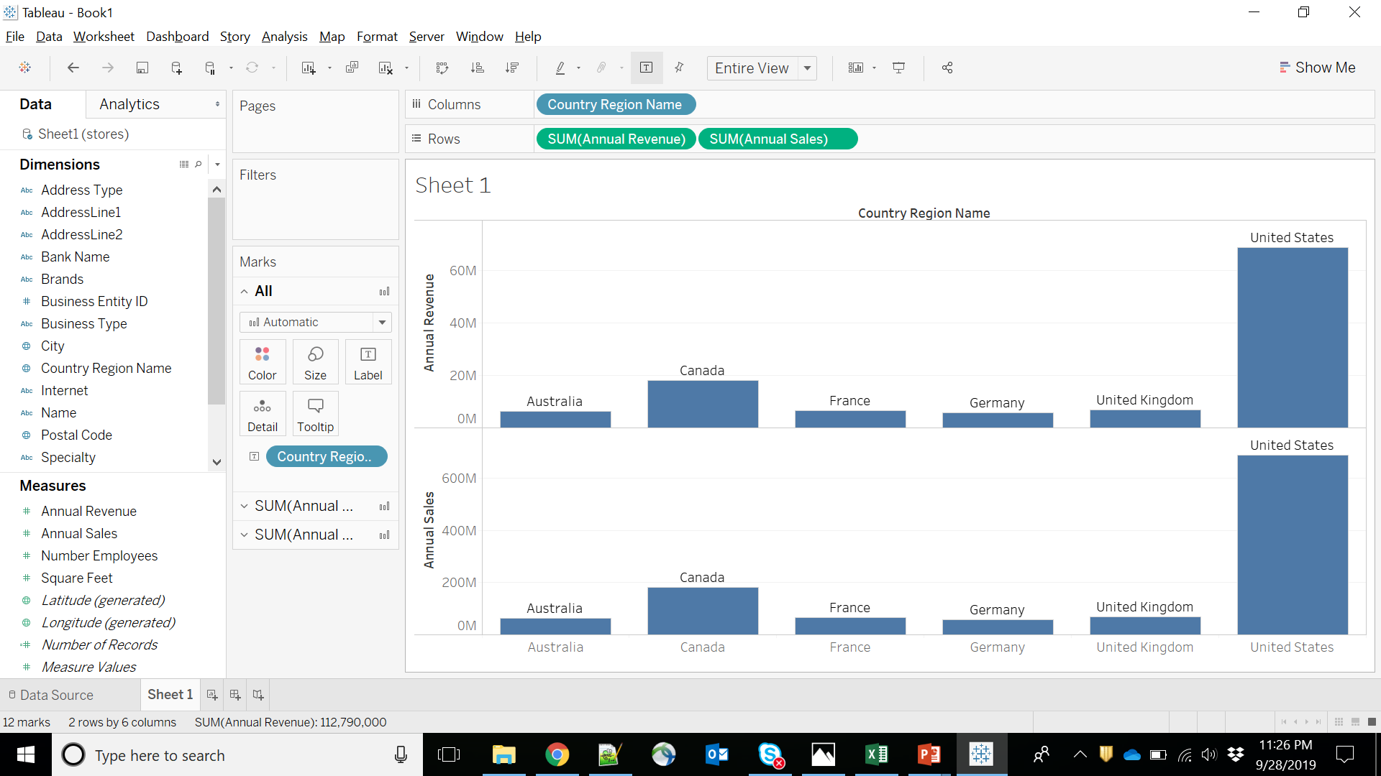

Slide 5
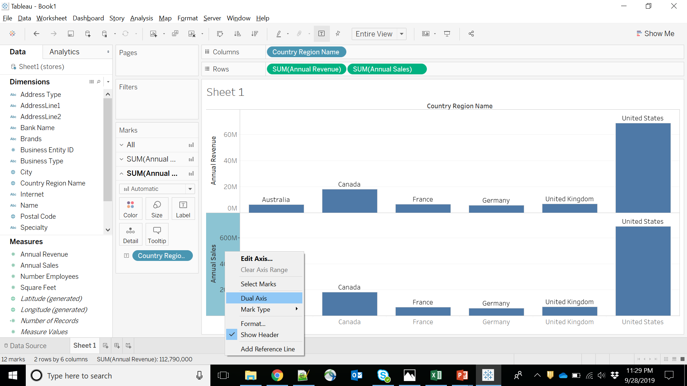

Slide 6
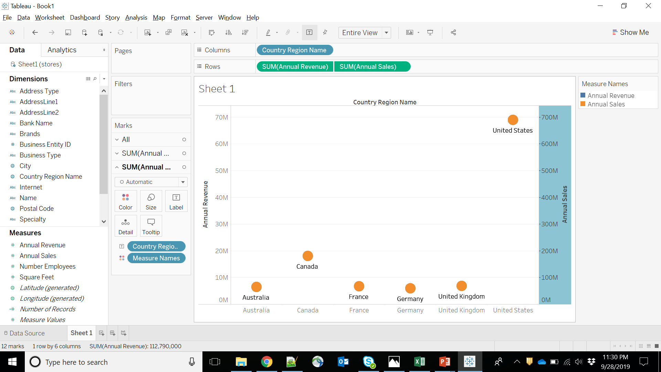

Slide 7
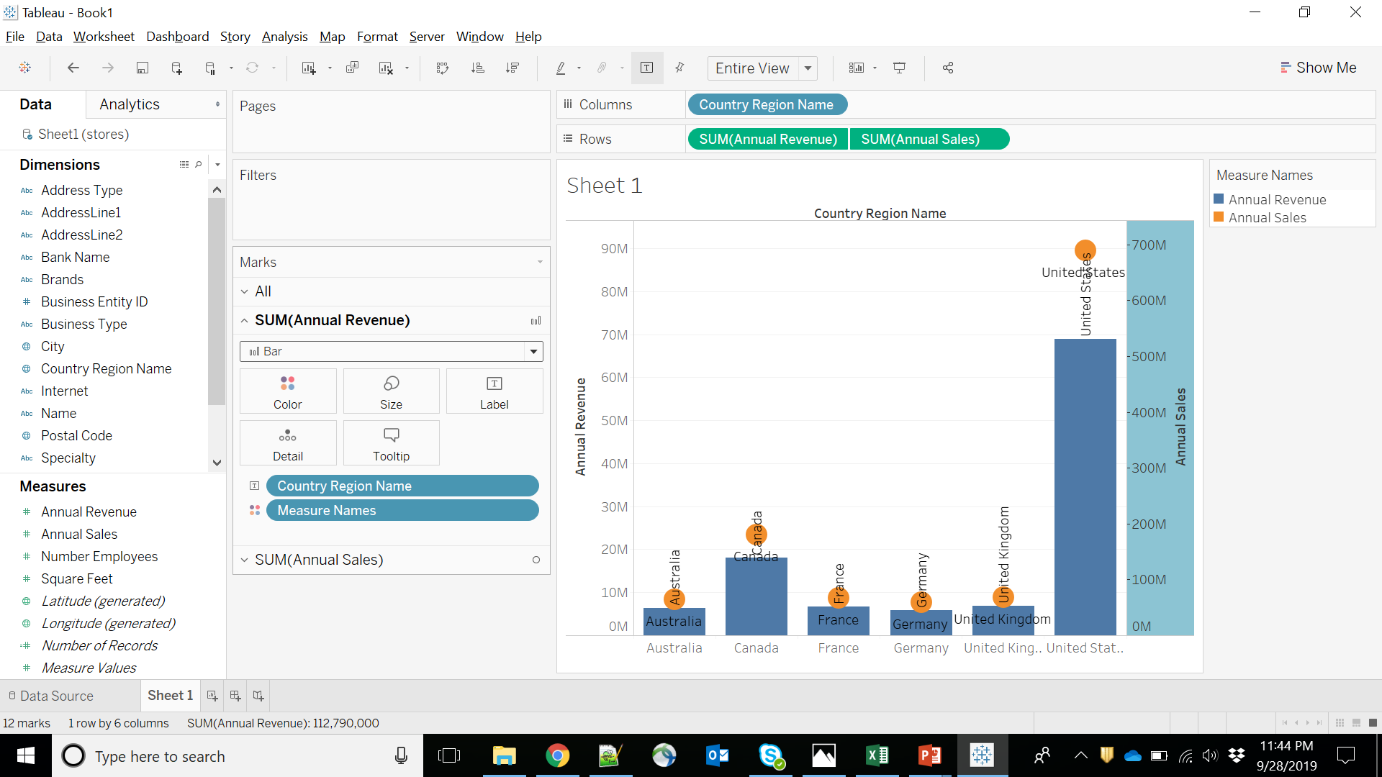

Slide 8
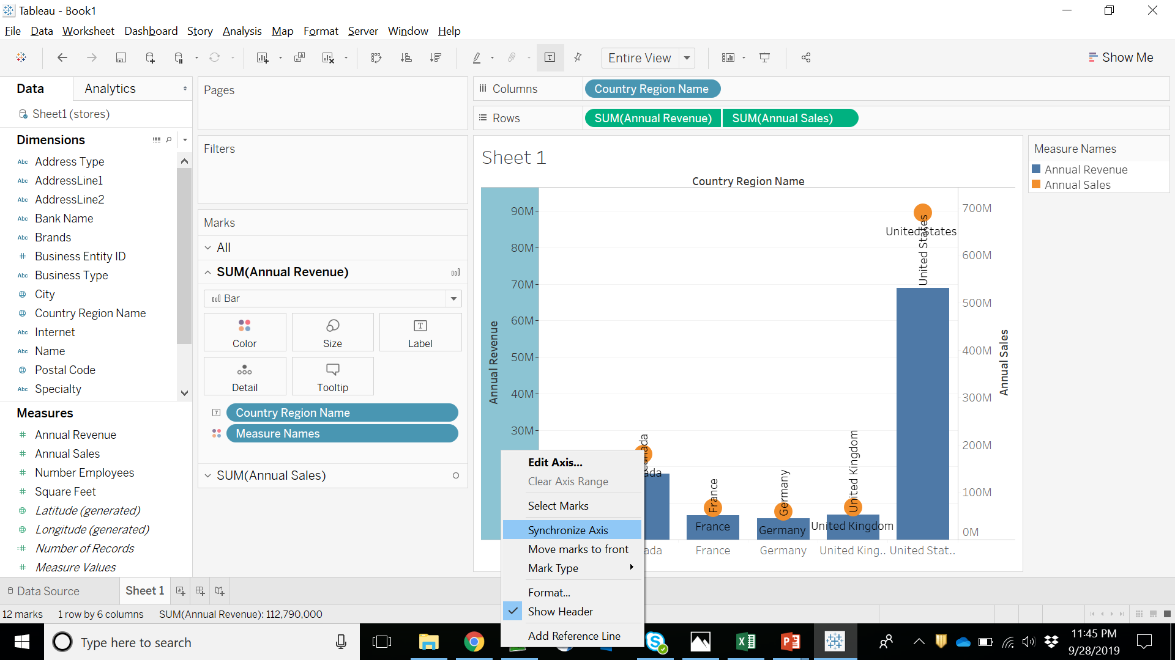

Slide 9
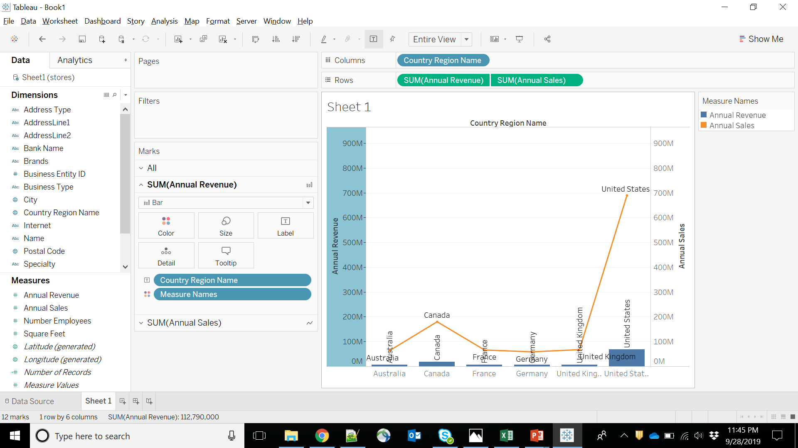

Slide 10
Use the dataset “stores”
Exercise 1. Objective: Scatter Plot
Import Stores Dataset.
Analyze Number of Employees vs Annual Sales for specialty wise country region Name.

Slide 11
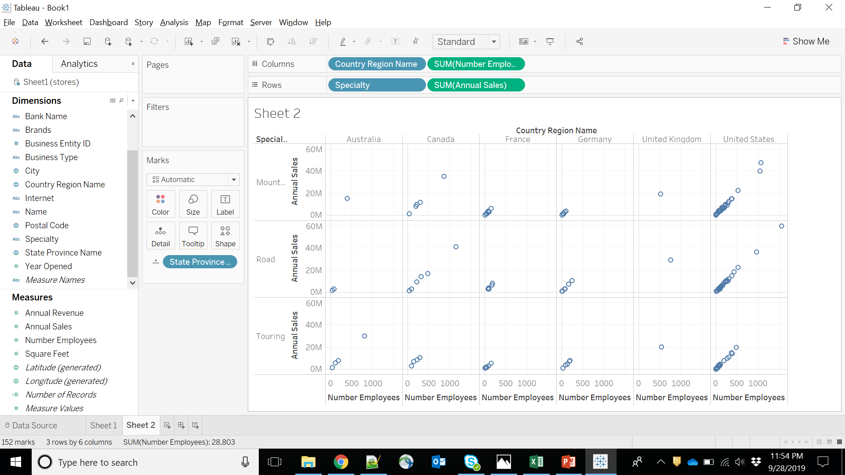

Slide 12
Motion Charts
Motion charts show data using the X and Y-axes, displaying changes over time by showing the movement of data points within the defined space as well as changes in the color of the lines.
The main advantage of motion chart is to view the entire trail of how the data has changed over time and not just a snapshot of the data.
Tableau needs one Time Dimension and one Measure to create a Motion chart.

Slide 13
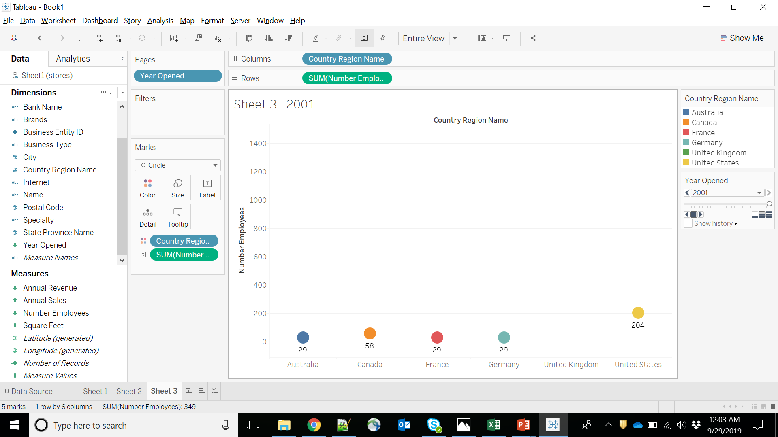

Slide 14


Slide 15
Motion Chart – Super Store Dataset
Steps:
Import your dataset, and create the aforementioned Trend Chart. Our X-axis was the Order Date (in the format of Month) and Sales and Profit are the Measures.
All you need to do to make the Motion Chart is drag Order Date over to the Pages shelf, and change the format again to match with the X-axis.
Change the Mark Type from Automatic to Circle.
Go to Show History, and select Trails to view the trend change. And voilà! Your Motion Chart is ready for launch.
Press on the arrow buttons to see the motions, change the Show History customizations, the speed etc

Slide 16
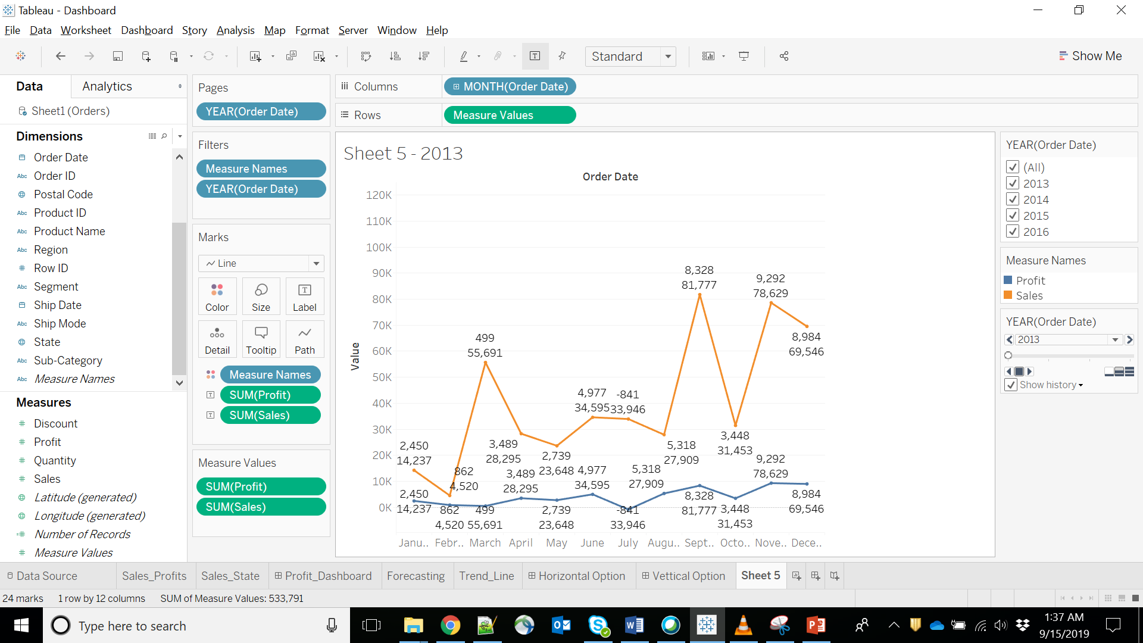

Slide 17
Use the dataset “stores”
Exercise 2. Objective: Build Hierarchy
Import The Dataset.
Go through the Columns.
Analyze Annual Revenue by the Hierarchy.
Hierarchy Name: Place
Attributes:
Country Region Name
State Province Name
City
Postal Code

Slide 18
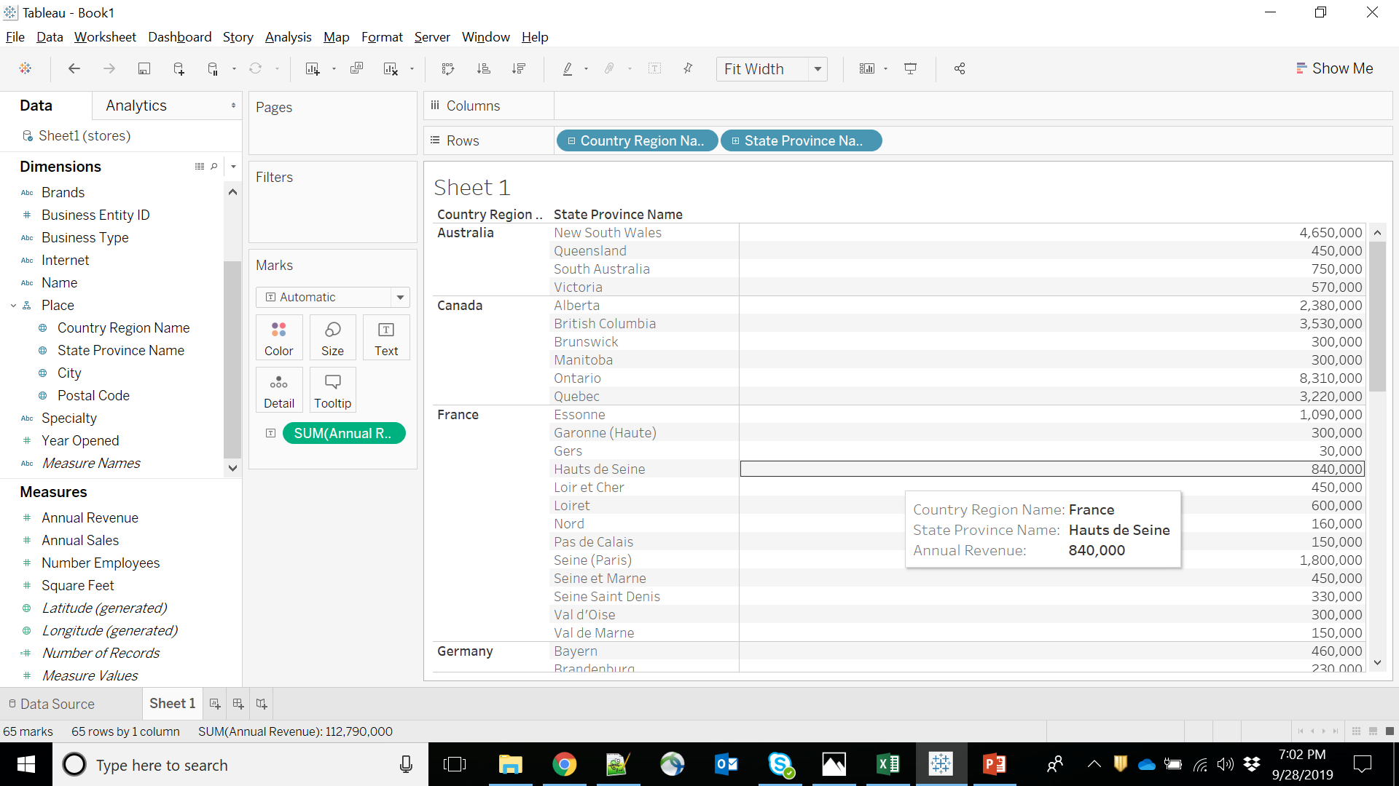

Slide 19
Creating Group
You can create a group to combine related members in a field.

Slide 20
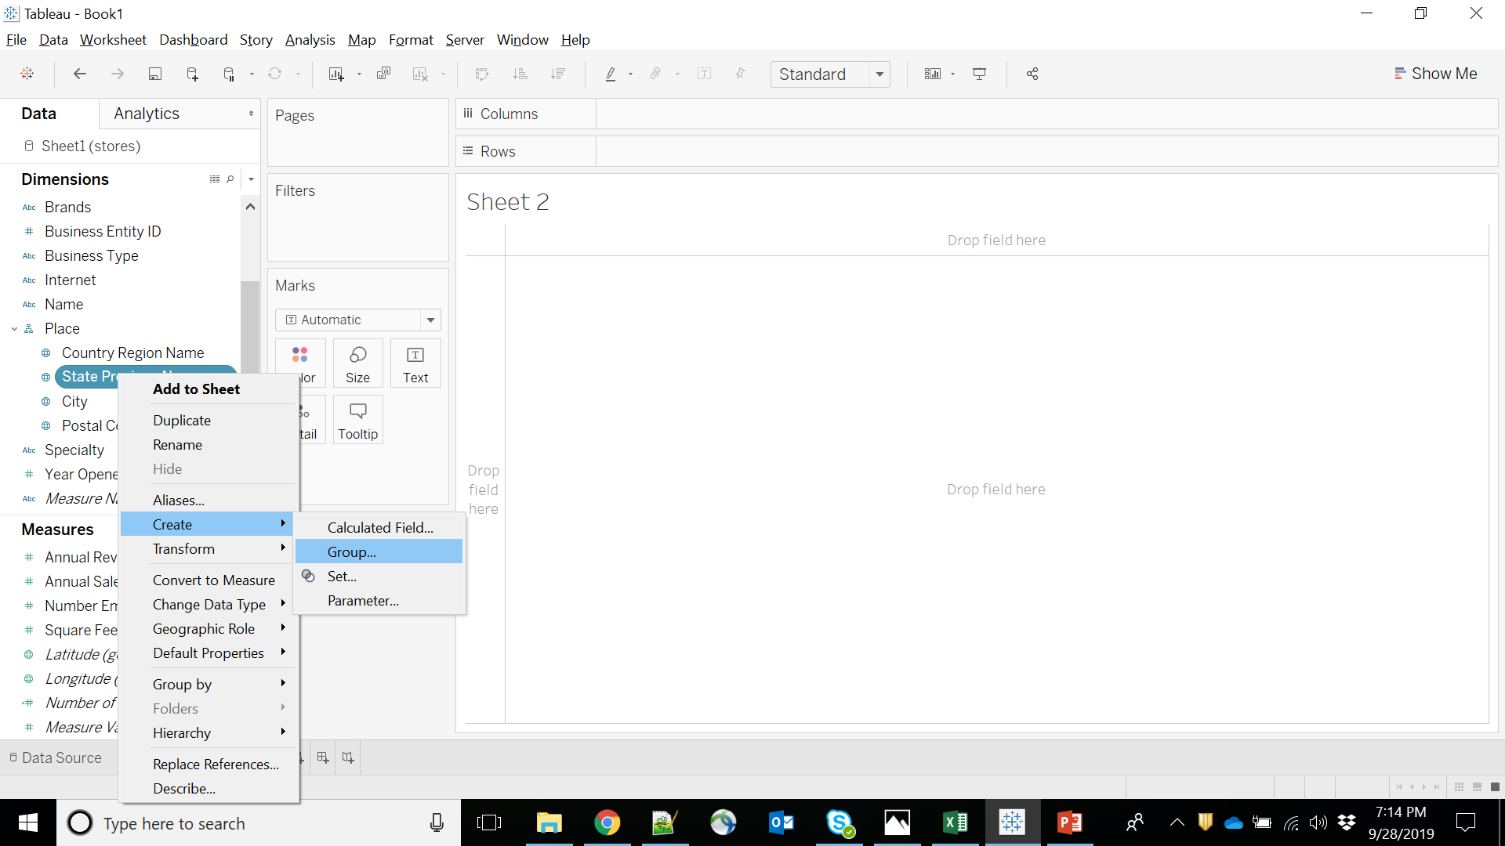

Slide 21
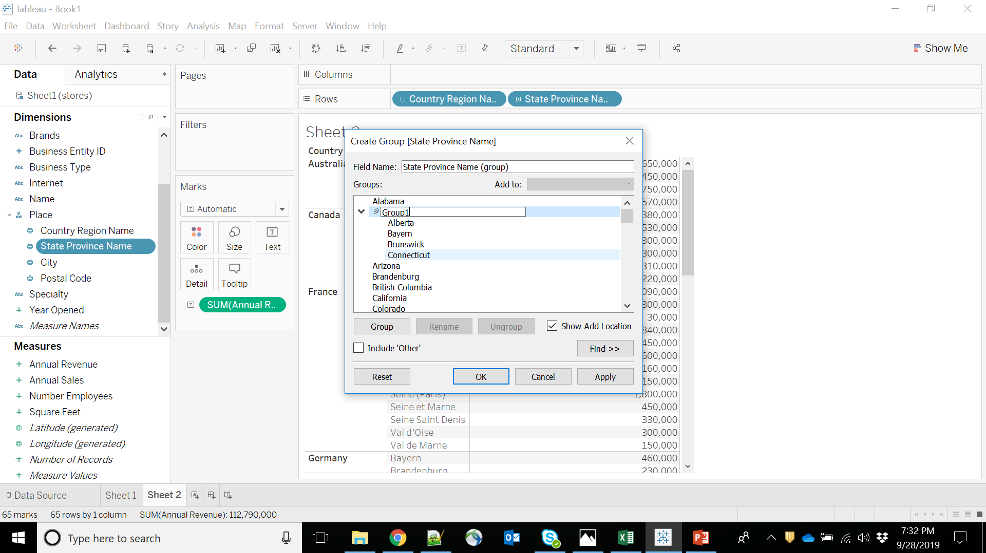

Slide 22
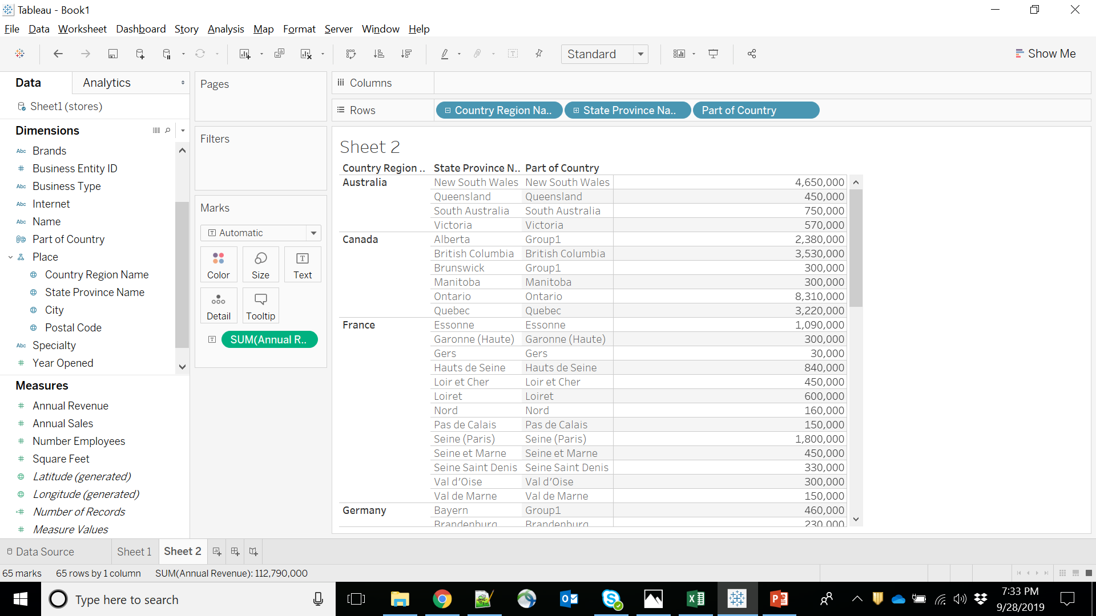

Slide 23
Creating SET
Tableau Set is a custom filed used to hold the subset of a data based on some condition.
In real-time Tableau set can be created by selecting members from the list. Or By writing custom Condition or Selecting Top or Bottom few records based on Measure value so on.
It will show the results in form of IN/OUT

Slide 24
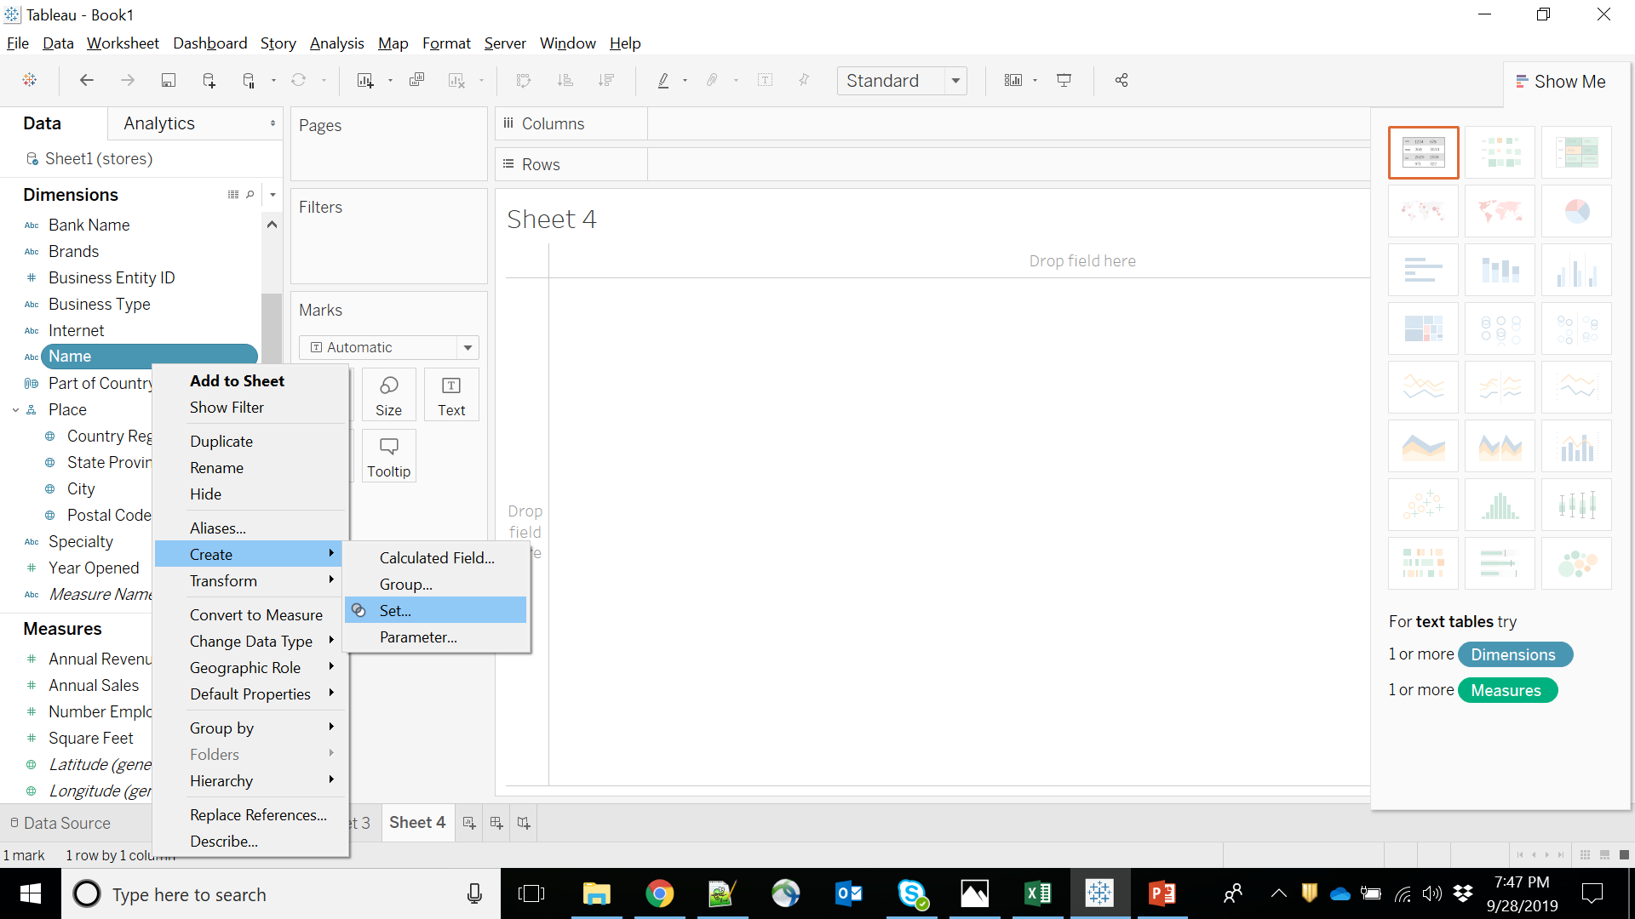

Slide 25
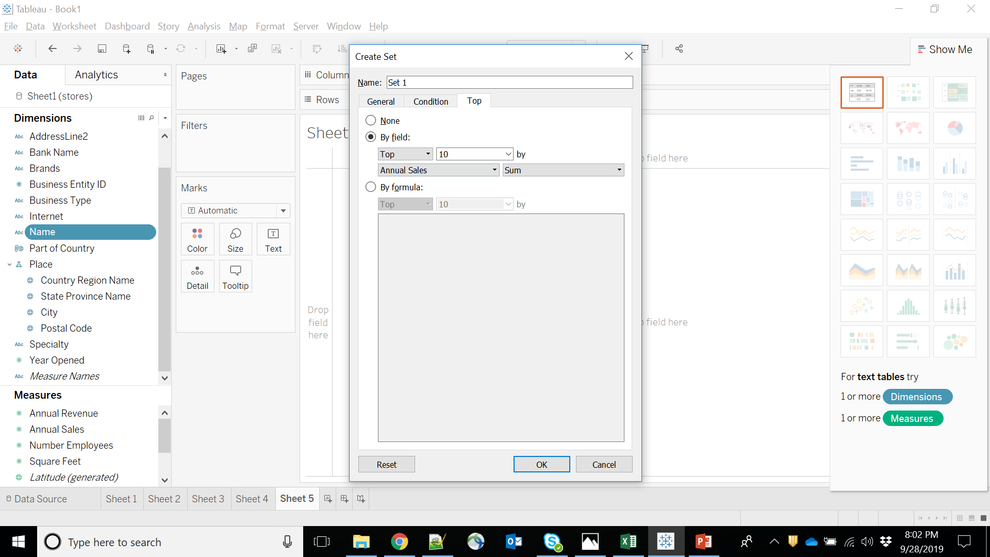

Slide 26
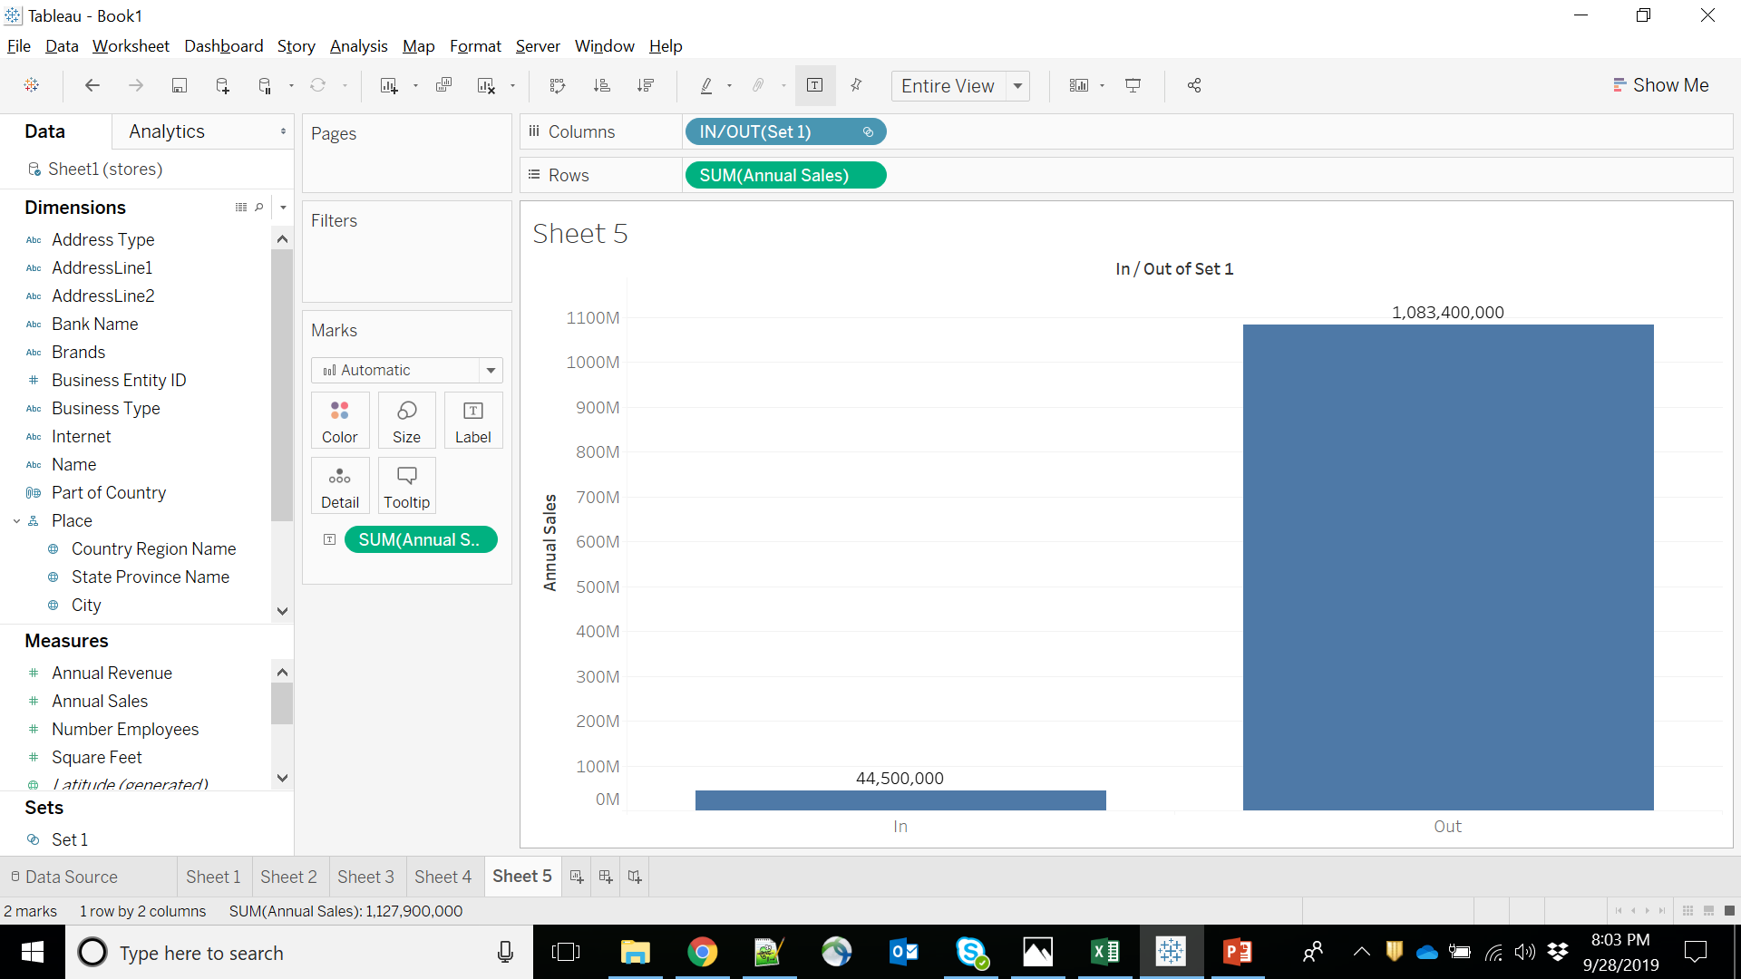

Slide 27
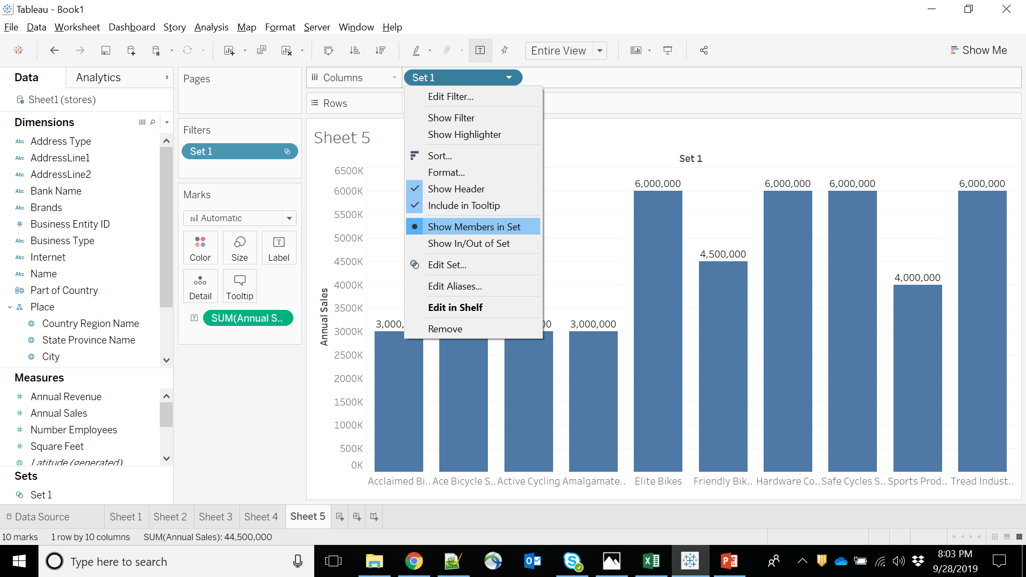

Slide 28
Practice
Import STATES Dataset.
Create a new viz, with State on the Rows shelf and Sum(Population) as a Text mark.
Create a new group, grouping together all states which start with the letter M.
Order the viz by Sum of Population descending.
Create a new set of "State (group)", containing the top 5 state groups based on Population.

Slide 29
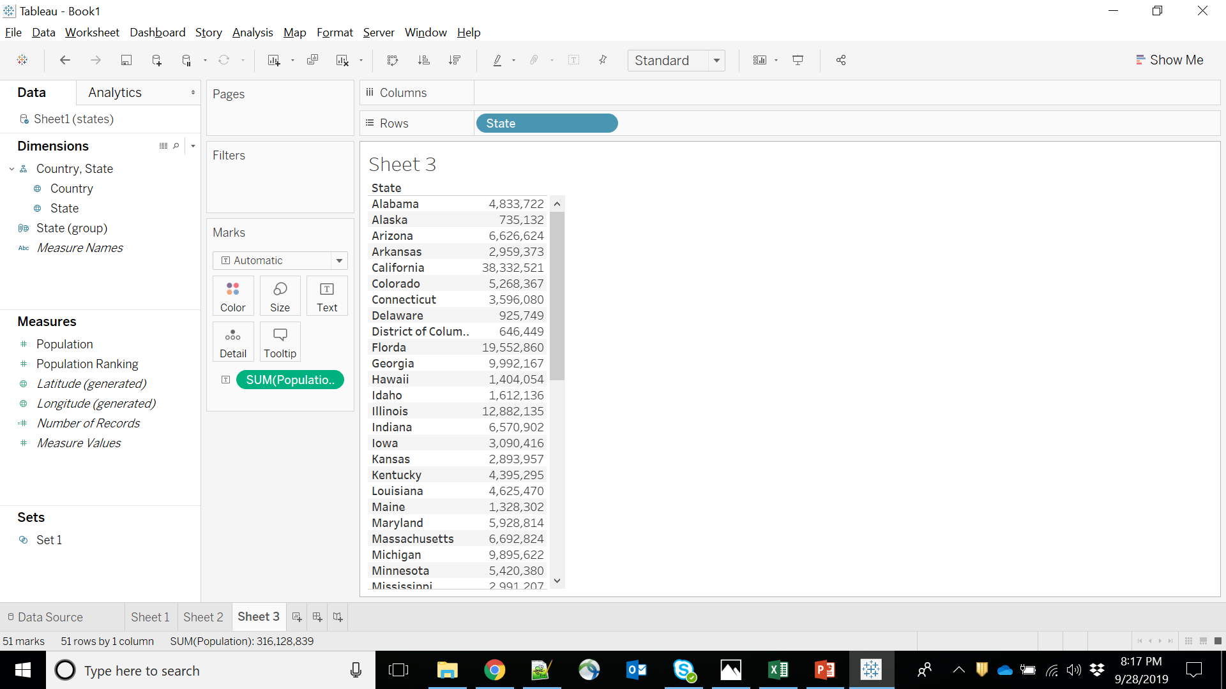

Slide 30
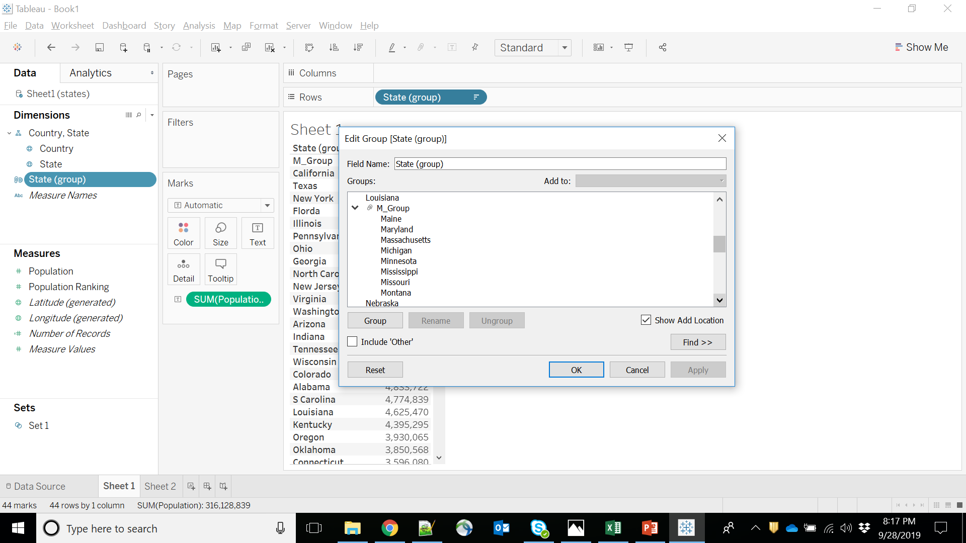

Slide 31
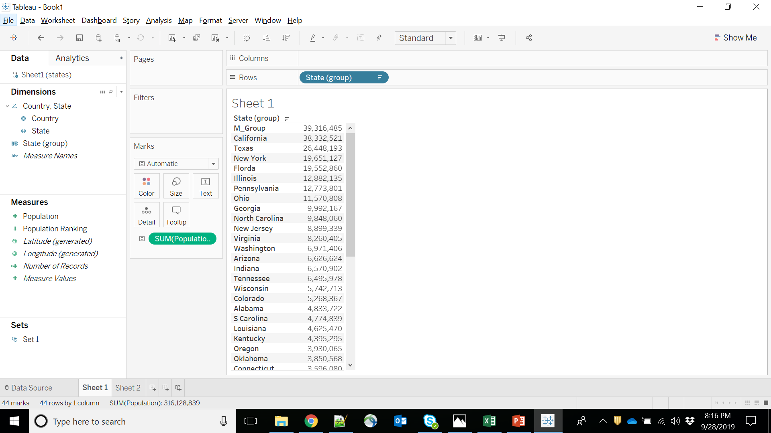

Slide 32
